Slide 1
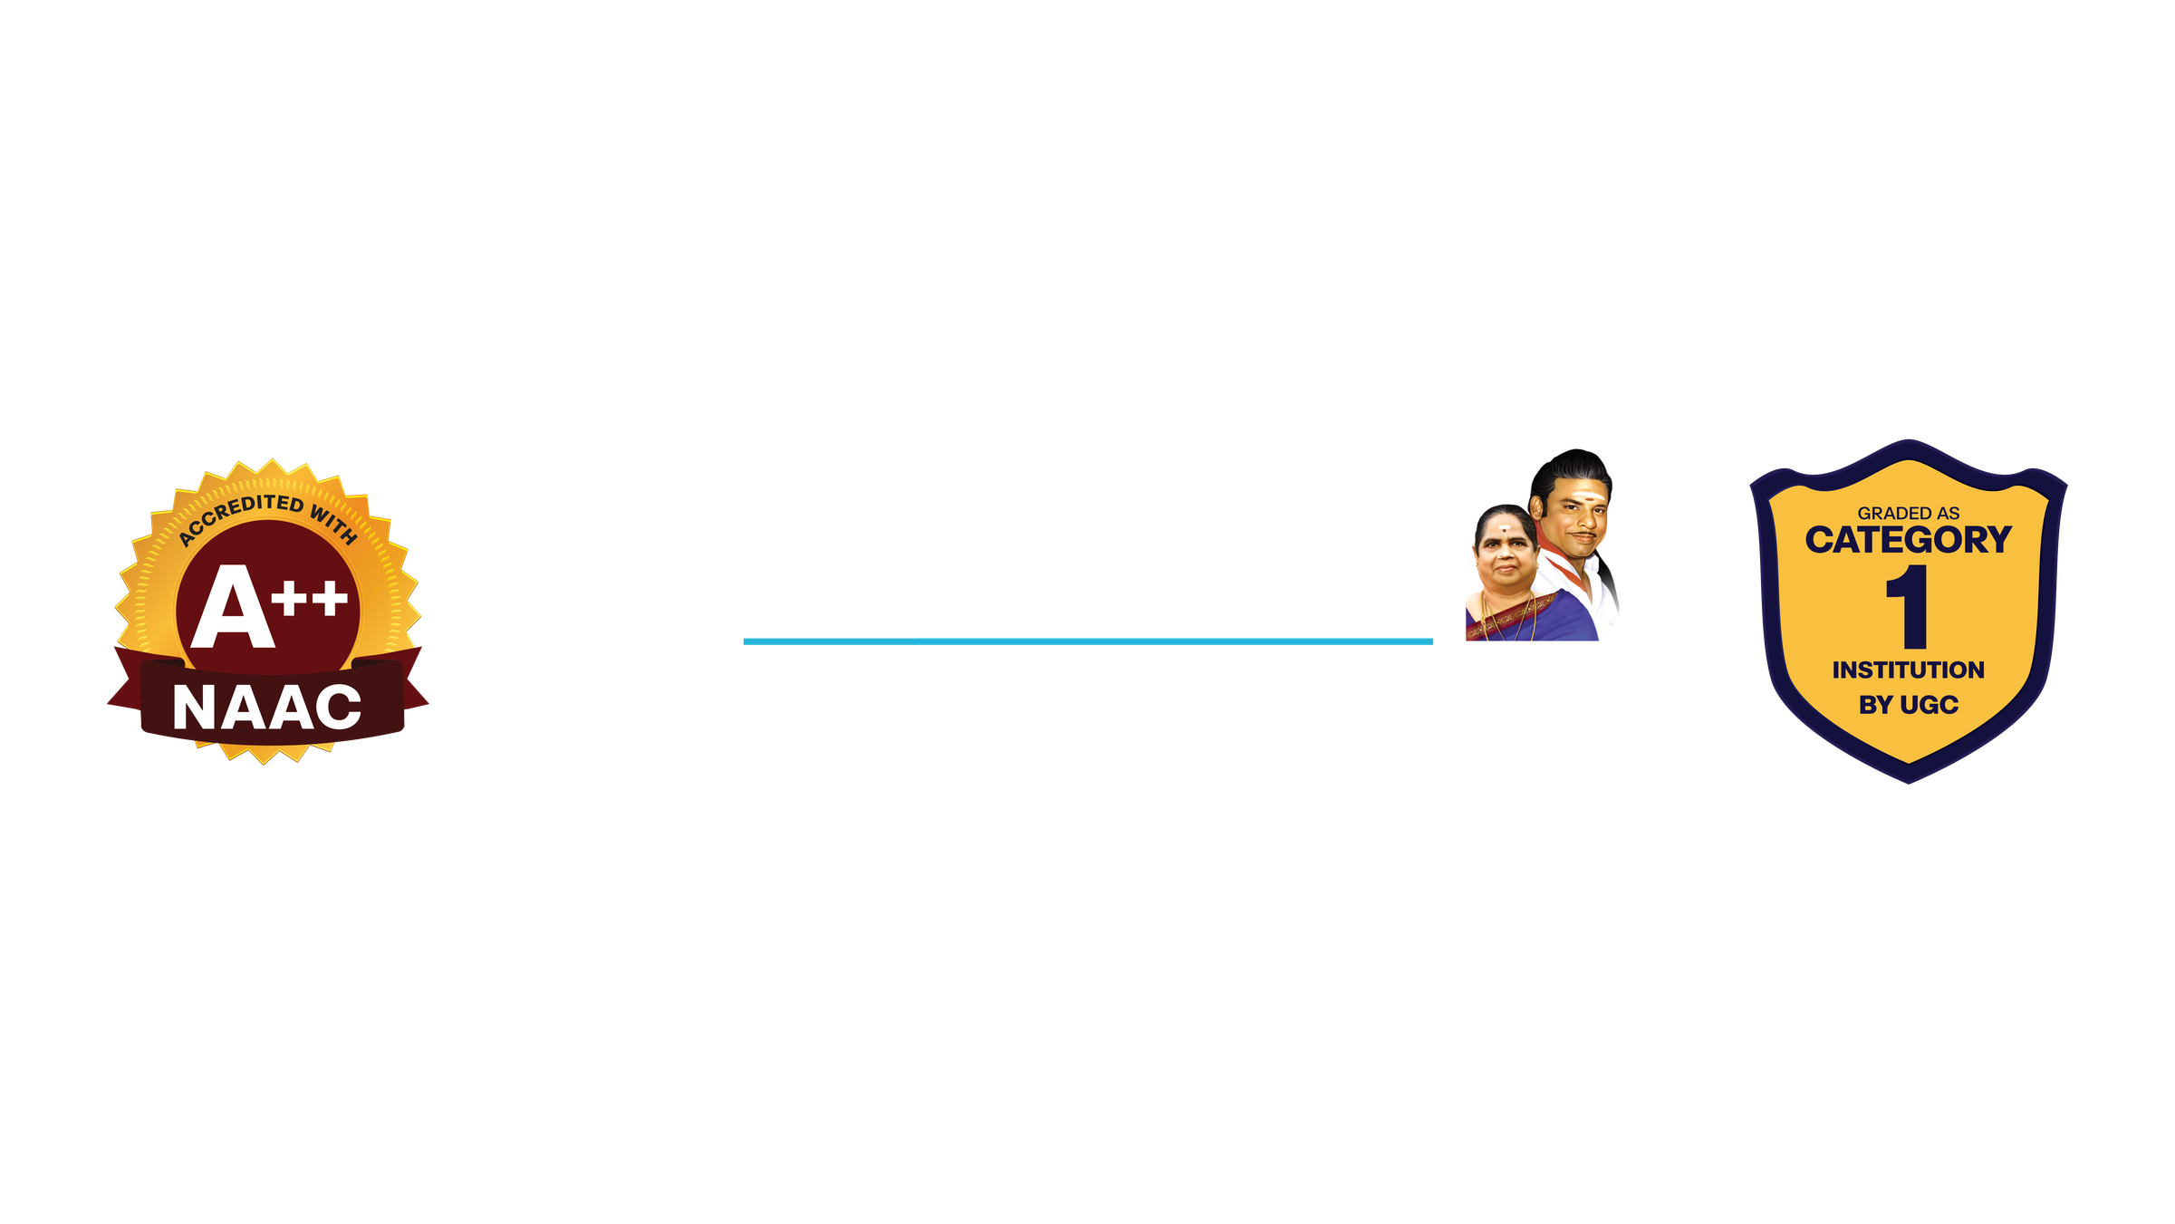
PROJECT PHASE -1
VISIONGUARD AI : A MULTILODAL FRAMEWORK FOR INTELLIGENT PATIENT MONITORING
NAME :
Dr. N.MEENAKSHIN
ROHAN.D , RAKESHKUMAR.S
GUIDE NAME:
REG NO :
23619227 , 23619234
DEPARTMENT OF AIML

Slide 2
PROBLEM STATEMENT
  Continuous monitoring of patients is important in ICU and observation areas.
  Traditional monitoring mainly depends on medical sensors and periodic observation.
  Some abnormal patient conditions may be difficult to identify immediately.
  Visual conditions such as unusual movement, falls, unconsciousness, pain and distress may not be captured by sensor data alone.
  Sensor data can identify physiological abnormalities, but it cannot fully understand the patient's visual behaviour.
  Therefore, a multimodal AI system is proposed by combining visual information and physiological/sensor information.
  The system aims to generate an early warning alert when an abnormal condition is detected.

Slide 3
OBJECTIVES
  Visual Monitoring ,Detect abnormal patient activities and conditions from images/videos.
  Physiological Monitoring
  Analyse sensor/vital-sign data to identify abnormal physiological conditions.
  Multimodal Fusion,Combine the outputs of the visual and sensor-based models.
  Emergency Alert,Generate a final alert when an abnormal or risky condition is detected.
  Explainable AI,Provide an explanation of why the system generated an alert.
Short version :
"Our main objective is to combine what the camera sees and what the sensors measure into one intelligent monitoring system."

Slide 4
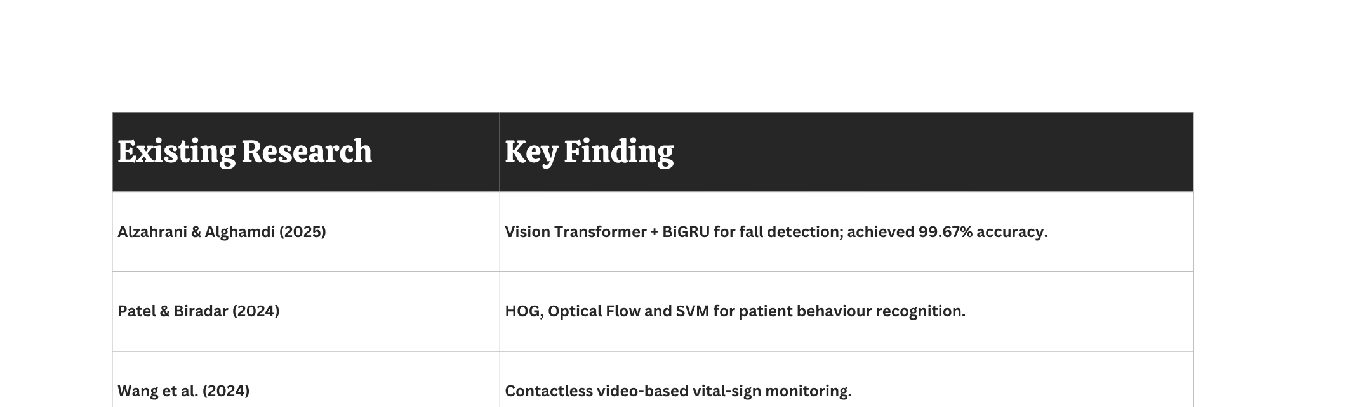
LITERATURE REVIEW / SURVEY

Slide 5
Research Gap
• Existing systems are mostly single-modality.
• Fall detection systems focus mainly on one specific behaviour.
• Limited integration of Computer Vision + IoT physiological sensing.
• Existing systems provide limited explainability for their predictions.
• Need for a proactive, risk-based and multimodal monitoring framework.
BASE PAPER :
Vision Transformer-based Fall Activity Recognition (Alzahrani & Alghamdi, Scientific Reports, 2025)

Slide 6
PROPOSED SYSTEM
• 1. Data Acquisition — ESP32-CAM captures real-time patient video; IoT sensors collect physiological parameters.
• 2. Computer Vision Analysis — Vision Transformer processes video; pose estimation and behaviour analysis identify abnormal activities.
• 3. IoT Sensor Processing — Heart rate & SpO₂, body temperature, and movement/activity data.
• 4. Multimodal Data Fusion — Behavioural information + physiological information are combined.
• 5. Risk Classification — Normal | Moderate | High | Critical.
• 6. XAI & Alert System — Explainable AI provides reasons for predictions; buzzer and monitoring dashboard provide real-time alerts.

Slide 7
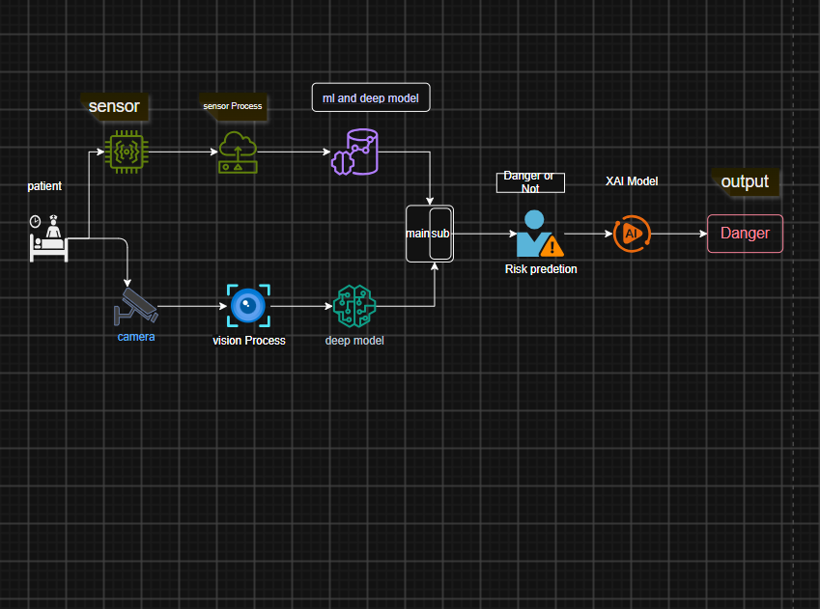
SYSTEM ARCHITECTURE

Slide 8
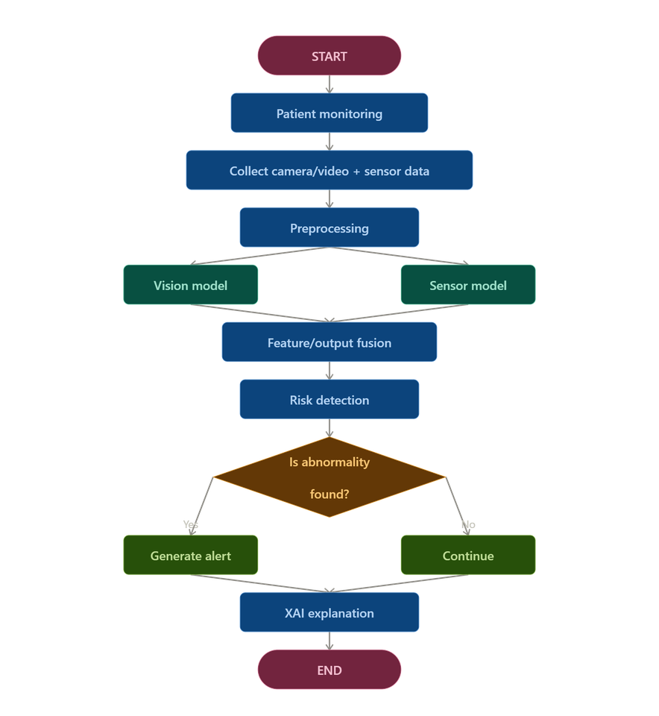
FLOW DIAGRAM

Slide 9
WORKFLOW
Step 1 — Data Collection
  Collect visual/video data.
  Collect physiological/sensor data.
Step 2 — Data Preprocessing
  Resize/normalize visual data.
  Clean and normalize sensor data.
  Prepare labels.
Step 3 — Model Training
  Train vision-based model.
  Train sensor-based model.
Step 4 — Model Evaluation
  Accuracy
  Precision
  Recall
  F1-score
Step 5 — Multimodal Fusion
  Combine outputs/features from both models.
Step 6 — Emergency Detection
  Determine normal/abnormal condition.
Step 7 — Alert Generation
  Generate warning when abnormality is detected.
Step 8 — Explainable AI
  Show important features/regions responsible for the prediction.

Slide 10
MODULES
Module 1 -Vision-Based Detection
  Extract visual features from patient images/videos.
  Detect abnormal patient behaviour.
  Classify normal and abnormal conditions.
Module 2 — Sensor-Based Detection
  Process physiological parameters.
  Identify abnormal sensor patterns.
  Predict patient risk.
Module 3 — Multimodal Fusion & Explainable AI
  Combine vision and sensor predictions.
  Improve overall decision reliability.
  Generate emergency alerts.
  Provide prediction explanation using XAI.

Slide 11
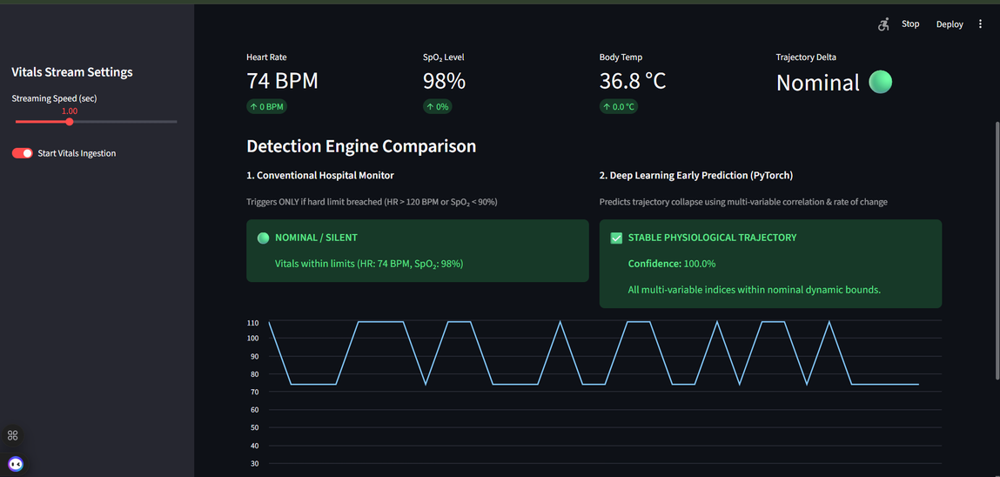
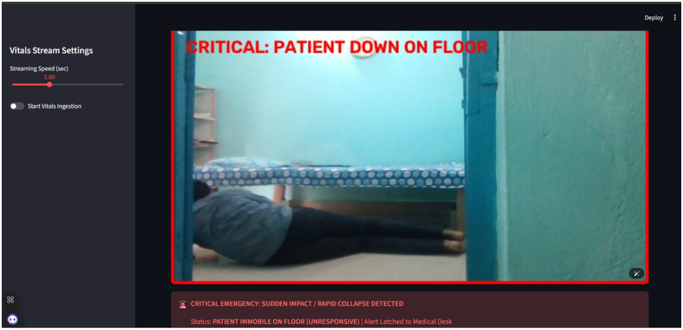
IMPLEMENTATION

Slide 12
SOFTWARE & HARDWARE USED
Software
  Python
  VS CODE
  TensorFlow / Keras
  OpenCV
  NumPy
  Pandas
  Scikit-learn
  Matplotlib
  XAI libraries such as Grad-CAM / SHAP
Hardware
📷 ESP32-CAM – Captures real-time patient images/video
🧠 ESP32 Development Board – Collects and transmits sensor data through Wi-Fi
❤️ MAX30102 Sensor – Monitors heart rate and SpO₂
🌡️ MLX90614 Temperature Sensor – Measures body temperature
🔌 Breadboard & Jumper Wires – Connects the IoT components

Slide 13
RESULTS & DISCUSSION
1.Physiological Model Performance:
Successfully executed real-time inference using the trained PyTorch MLP model (vital_sign_model.pth) on sequential test data. Demonstrated early proactive warning capabilities, flagging multi-variable collapse trajectories before traditional static thresholds are breached.
2.Visual Monitoring Branch:Implemented an OpenCV algorithmic baseline utilizing temporal frame differencing and centroid tracking. Integrated state-latching logic to successfully detect bed falls, rapid impacts, and critical post-fall immobility.
3. Dashboard Integration:Built a fully interactive Streamlit web application providing live telemetry metrics, rolling line charts, and side-by-side detection comparisons.

Slide 14
CHALLENGES FACED
1.Dataset Availability: It was challenging to find clean, open-source clinical datasets that properly combine synchronized patient vital signs with video monitoring footage.
2.Model Training & Tuning: Tuning the neural network hyperparameters, handling data imbalances, and ensuring the model accurately predicts emergencies without false alarms.
3. Sensor & Hardware Issues: Dealing with physical sensor noise, calibration differences, and managing the transition from simulated data arrays to actual hardware components.

Slide 15
FUTUREWORK
1.Phase 2 Hardware Deployment: Directly flashing physical ESP32 microcontrollers, MAX30102 pulse oximeters, and MLX90614 temperature sensors to stream live packets into the dashboard endpoint.
2.Advanced Vision Models: Upgrading the OpenCV algorithmic baseline to a full Vision Transformer (ViT) or 3D-CNN pose-estimation model trained on the Urfall and ADL datasets.
3. Clinical Notification Webhooks: Integrating SMS/push notification APIs to route emergency alerts directly to nurse station pagers.

Slide 16
REFERENCES
  Alzahrani, A., & Alghamdi, M. (2025). "Vision Transformer-based Fall Activity Recognition." Scientific Reports.
  Patel, R., & Biradar, S. (2024). "Patient behavior recognition using HOG, Optical Flow, and SVM." Journal of Medical Systems.
  Wang, et al. (2024). "Contactless video-based vital-sign monitoring in hospital environments." IEEE Transactions on Biomedical Engineering.
  Rani, et al. (2024). "IoT and AI integration for predictive healthcare telemetry." Elsevier Computer Communications.

Slide 17
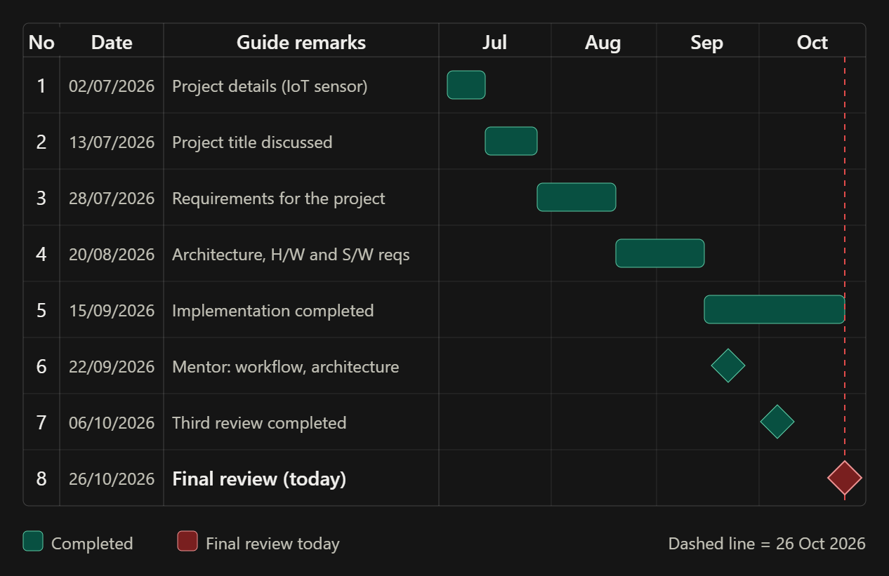
Gantt chart

Slide 18
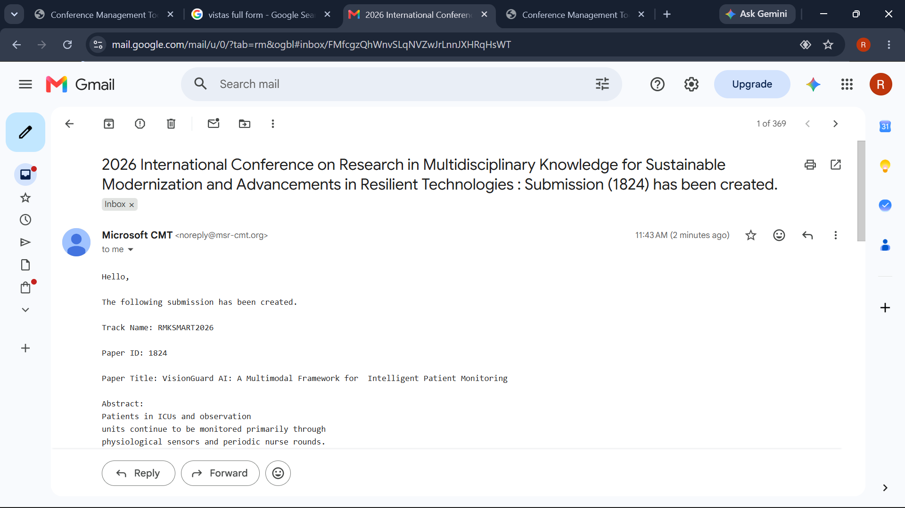
IEEE CONFRENCE SUBMITION

Slide 19


